Slide 1
Adventures Around Rock Springs and Green River
Presentation by Jim and Paula Taylor
307-222-2121
1:00-2:00 Wednesday, June 19, 2024 in Small Hall

Slide 2
About US
Jim has worked in the Rock Springs area for the last 7 years, is an RV Hacker, solar enthusiast, IT Engineer, 25 year RV’er, Mini driver, Harley rider, photographer, skydiver, black smith, and USAF Retired.
Paula is a 5th generation Wyoming ranch daughter, with her master’s degree in history from the University of Wyoming. Taught “History of Wyoming” at college level. Retired as the Museum Director for the Warren ICBM & Heritage Museum located at F. E. Warren AFB, WY. Paula is a published author with her book, “F. E. Warren AFB.”

Slide 3
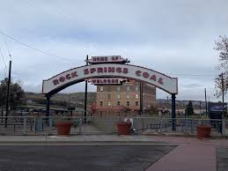
Rock Springs
Located in Sweetwater County, is the 5th largest populated city in Wyoming with 37,975 people
Rock Springs derives its name from a rock spring which flowed in the Number 6 district in the northern part of town. An erroneous story had indicated that the spring was found by a lost Pony Express rider, but the spring station was known to Jim Bridger, a famous Mountain Man that settled at trading post now known as Ft. Bridger before 1860. The spring disappeared when the coal mine operations interrupted the underground flow. Later an 'S' was added to the name making it "Rock Springs".
Trails that went through Rock Springs: Oregon Trail, Pony Express and the Overland Trail
Rock Springs is known for their iconic Flaming Gorge National Recreation Area, the fascinating Natural History Museum, there's definitely something for everyone in this Wyoming city.

Slide 4
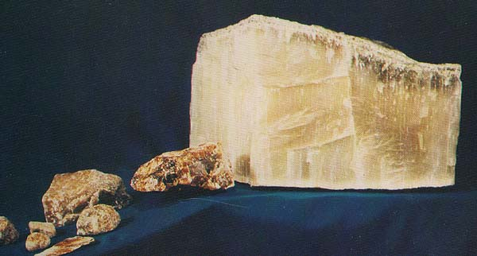
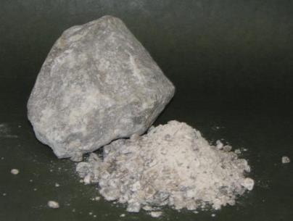
Trona Mining
Trona (mineral that contains sodium sesquicarbonate) is a relatively rare sodium-rich mineral found in the United States, Africa, China, Turkey, and Mexico.
1770’s Synthetic - LeBlanc process – Salt, Sulfuric Acid & Limestone
1938: Trona discovered in Green River basin while drilling for oil & gas
1949: Natural method first produced in 1948

Slide 7
Flaming Gorge National Recreation Area
Rock Springs is known for their iconic Flaming Gorge National Recreation Area
Fishing along the shoreline, Boating and jet skiing across expansive waters, hiking and Mountain biking to incredible vistas, horseback riding through breathtaking scenery, camping, taking an educational tour,
From I-80 in southern Wyoming, take exit 99 in Rock Springs and head south on highway 191. Or you can travel south of Green River on Hwy 530.

Slide 8
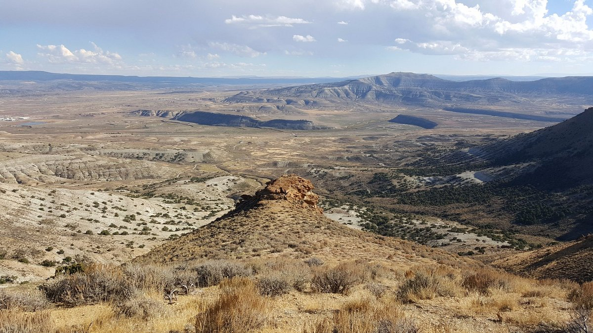
Wild Horse Scenic Loop
The 24-mile self-guided Pilot Butte Wild Horse Scenic Tour can begin in either Green River or Rock Springs. Travelers should plan on approximately 1.5 hours to complete the tour, most of which is on a gravel road.

Slide 9
Wild Horse Scenic Loop
Watch for wild horses between Rock Springs and 14-Mile Hill, and all the way across the top of White Mountain. Although this is a relatively dry area with sparse vegetation, it is also home to a variety of wild animals, including pronghorn, elk, deer, rabbits, coyotes, hawks, eagles and sage-grouse, among others. Wildlife viewing is best in the early morning and late afternoon hours. The majority of wild horses in Wyoming are located in the southwestern part of the state. The appropriate management level for wild horses in Wyoming is approximately 2,490 to 3,725 horses. Approximately 1,100 to 1,600 wild horses can be found on the public lands managed by the Rock Springs Field Office. This is a fee-free area. Sites are ADA accessible
https://www.blm.gov/visit/pilot-butte-wild-horse-scenic-tour
Directions
*From Rock Springs: Take exit 104 off of I-80 and travel north on Elk Street/Highway 191 approximately 14 miles to County Road 4-14 (Fourteen-Mile Road). Turn left onto 4-14 and travel 2.5 miles, then turn left onto County Road 4-53. Follow 4-53 south for 21.5 miles to Green River.
*From Green River: Exit I-80 to Flaming Gorge Way. Turn north onto Wild Horse Canyon Road. - put Hampton Inn & Suites Green River in your map program and do the loop from Green River to Rock Springs. I recommend doing it this direction.

Slide 10
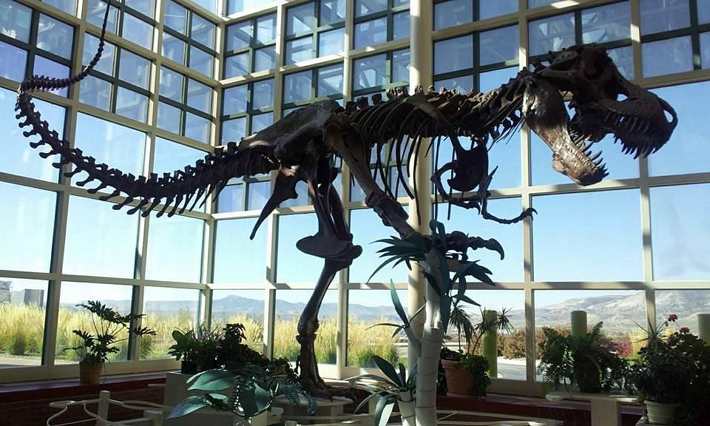
Dinosaur Surprise!
Western Wyoming Community College houses the Natural History Museum which includes five life sized dinosaur displays. They are the largest easily accessible collection of dinosaurs along I-80 from Chicago to San Francisco. There are also many other displays of regional fossils from Green River Formation fish to Oligocene lizards. Rock slabs showing interesting geological features also adorn the hallway walls. All displays are free and open to the public whenever the college is open.
Majority of Western Wyoming Community College is free to the public to tour and park.
2500 College Drive
Rock Springs, WY
https://www.westernwyoming.edu/campus-map/exhibits-on-campus/dinosaurs.php
https://travelwyoming.com/listings/natural-history-museum/

Slide 11
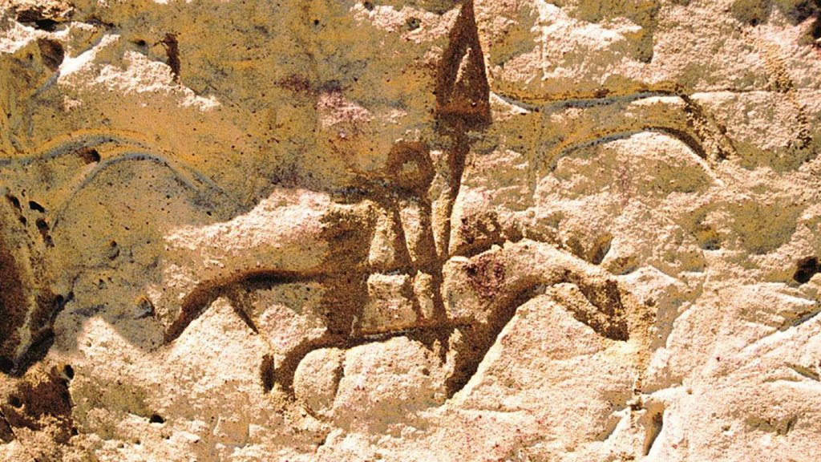
White Mountain Petroglyphs
These petroglyphs were carved by the ancestors of present Plains and Great Basin Native American People. They include drawings of elk, buffalo, horses, teepees and several kinds of human figures.
https://www.explorewy.com/explore/sightseeing-and-attractions/white-mountain-petroglyphs
Directions
Take State Highway 191 north to mile marker 10. Go East on County 4-17 thirteen miles. Head West on the White Mountain Petroglyphs access route. It is three miles to the parking area. A 2/3 steep walking path leads through the pedestrian gate and to the site.

Slide 12
Surf the Killpecker Sand Dunes
One of the many highlights of desert topography is soft, warm sand, and Killpecker Sand Dunes has plenty of it. Located a little north of Rock Springs, the dunes offer everything an outdoorsy adrenaline-chaser could want, including excellent sand surfing, sand skiing, ATVing, and more.
But amid this reddish-gold outdoor oasis, a secret awaits you. When the sand is moved at Killpecker, it makes a sound like someone singing due to a deviation in grain size and shape. There are only seven dunes like this in the world, so come check it out.
Much like White Sands National Park you can Surf the dunes.
Directions
OPEN PLAY AREA ACCESS Access is by the Tri-territory Road (County Road 4-17), which leaves U.S. Highway 191 approximately 12 miles north of Rock Springs. CAMPGROUND Travel north on State Highway 191 from Rock Springs for 12 miles and turn right (east) on to County Road 4-17/Tri-Territory Loop Road for 20 miles. Turn north onto the Sand Dunes access road for 1 mile.

Slide 13
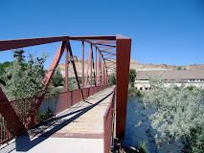
Expedition Island in Green River
History + Family Fun in the Middle of the Green River
Expedition Island is an island in the Green River at downtown Green River, Wyoming. This island oasis is the perfect spot for family picnics and Blue Ribbon trout fishing. It also serves as the ideal launching off point for tubing, kayaking and rafting on the river.
Take a stroll on the island’s beautiful Greenbelt Pathway while the kids monkey around on the playground.
Expedition Island is a National Historical Site due to its role as the starting point for two expeditions down the Green and Colorado Rivers led by Maj. Powell in 1869 and 1871. Powell began both trips near Expedition Island and mapped the river system, successfully documenting the Grand Canyon. It’s generally considered that on these expeditions Powell completed the exploration of the last, large unknown land area in the continental United States.
Expedition Island Park is a 7.1 acre community park located at 475 South Second East Street.
https://www.explorewy.com/explore/sightseeing-and-attractions/expedition-island
https://en.wikipedia.org/wiki/Expedition_Island

Slide 14
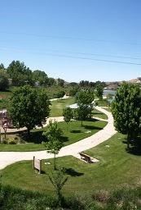
Green River Pathway System
The City of Green River is home to over 12 miles of a series of connector trails that include the Greenbelt Trail System; which meanders alongside the banks of the Green River. So… get out of the house, take a walk, get on your bike, breathe the fresh air and enjoy the sunshine as you stroll along the pathway. Explore the pathways twisting and turning through the corporate limits of Green River; the Iowa Bridger, Upland and CIG/Conoco pipeline trails are comprised of 1.9 paved miles traversing through the residential areas or if you prefer taking your walk in an open space you might want to venture to Expedition Island park where you can begin your walk and take in a bit of the area history and nature.
Pathway System Map

Slide 15
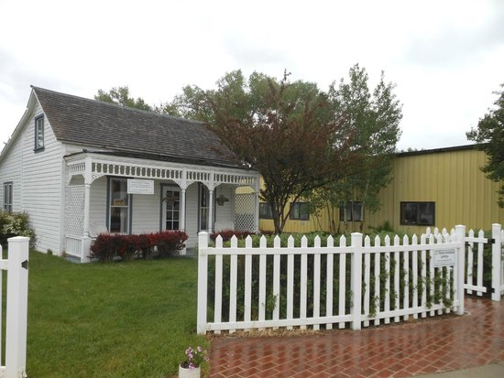
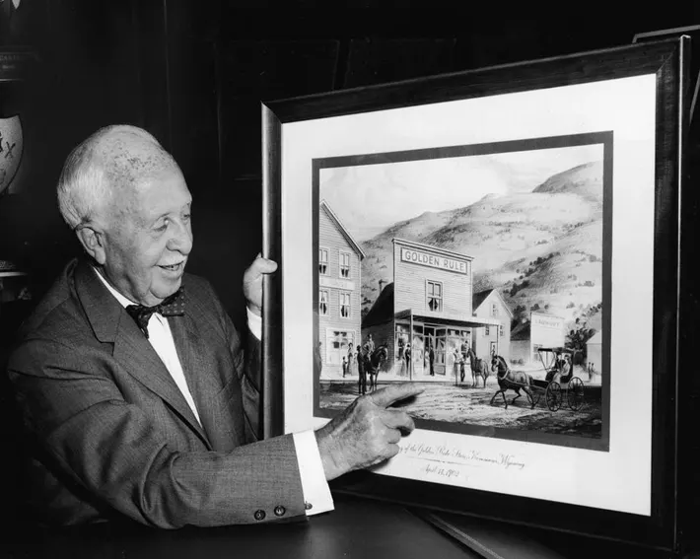
J. C. Penny’s
J.C. Penney was founded in Kemmerer, Wyoming, in 1902 by James Cash Penney. The first store, originally named The Golden Rule, set the standard by which he operated for over a century – to treat others as we would like to be treated. He sold a wide variety of good merchandise at reasonable prices. The first day of opening the store he sold $466.59 . After selling $29,000 in the first year he opened up other stores. By 1920 he had 312 stores in the nation and by 1929, he had a booming catalog business.

Slide 16
Seedskadee National Wildlife Refuge
The name Seedskadee originated from local tribes' word "Sisk-a-dee-agie" meaning "river of the prairie hen." The 26,210 acre Refuge protects a mosaic of riparian , wetland, and upland shrub habitats along 36 miles of the Green River in southwest Wyoming. The area was used by nomadic Indian tribes, fur trappers, and early pioneers. Thousands of pioneers crossed the treacherous Green River on what is now Seedskadee National Wildlife Refuge. The Oregon, Mormon, and California Trails, as well as the Pony Express Route, which all cross the refuge, have been designated as National Historic Trails by Congress. Jim Bridger and others operated ferries on the Green In the 1840's and 1850's. To this day, some of the trails can be traced across the Refuge by their ruts.
Seedskadee National Wildlife Refuge was established in 1965. The Seedskadee Reclamation Act of 1958 specifically authorized acquisition of lands for Seedskadee National Wildlife Refuge.
Seedskadee Rd, Green River, WY 82935

Slide 17
Local Area Business
Bitter Creek Brewing in Rock Springs – Great food and brews
604 Broadway St, Rock Springs, WY 82901- https://bittercreekbrewing.com/
Badass Brews Brewery in Green River – Great beers – Local miner and her veteran husband run it.
98 N 1st E St, Green River, WY 82935
Thai Chef 9 – Thai food, Great food!! - Don’t judge a book by it’s cover - very close to the Events complex
1758 Elk St, Rock Springs, WY 82901
Sapporo – Japanese Steak House – Hibachi, Sushi, Full Bar, -
2461 Foothill Blvd, Rock Springs, WY 82901 - http://www.sapporowy.com/

Slide 18
Local Area Business
Casa Chavez Mexican Restaurant – another don’t judge the book by it’s cover
744 Pilot Butte Ave, Rock Springs, WY 82901
Broadway burger Station Rock Springs – 50’s Diner Shacks Malts Frys - Best hamburger in Wyoming – Also a sponsor of Escapade
628 Broadway St, Rock Springs, WY 82901
https://www.broadwayburgerstation.com/
Don Pedro’s Family Mexican Restaurant – Best Mexican food in the area - Getting to it, is a bit strange. It is behind the Harley Davidson Dealership in Green River
520 Wilkes Dr #10, Green River, WY 82935
https://www.donpedrosfamilymexicanrestaurant.com/green-river-wy

Slide 19
Local Area Business
Fastfood:
Taco Time in Rock Springs and Green River
1639 Elk St, Rock Springs, WY 82901
Arctic Circle – Black Angus Pastrami and Swiss!!!!
445 E Flaming Gorge Way, Green River, WY 82935
Stellar Coffee and Ice Cream Shop in Green River – Best coffee in the area IMHO.
705 Uinta Dr Ste A, Green River, WY 82935
Coal Train Coffee Depot – In the old train Depot in Rock Springs – Best coffee in Rock Springs - sit down great atmosphere - https://www.coaltraincoffeedepot.com/
Hooligans Espresso - Best drive through coffee in Rock Springs
1481 Dewar Dr, Rock Springs, WY 82901

Slide 20
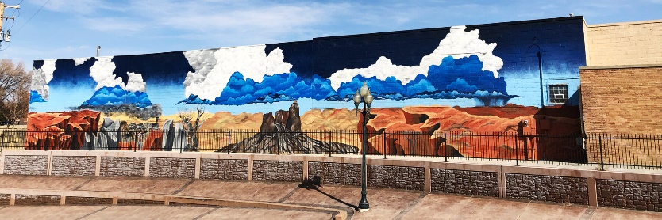
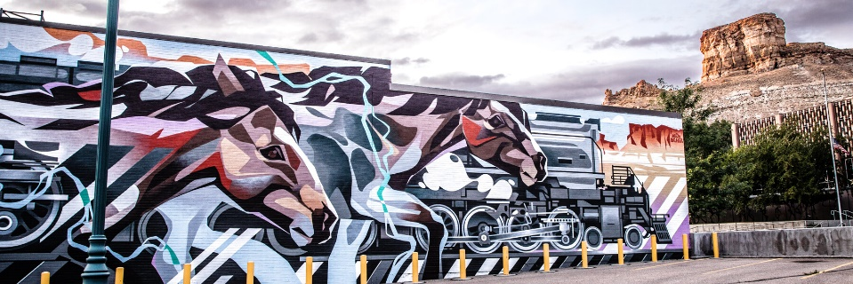
Murals in Downtown Rock Springs
https://www.explorewy.com/travel-tools/itineraries/murals-downtown-rock-springs

Slide 21
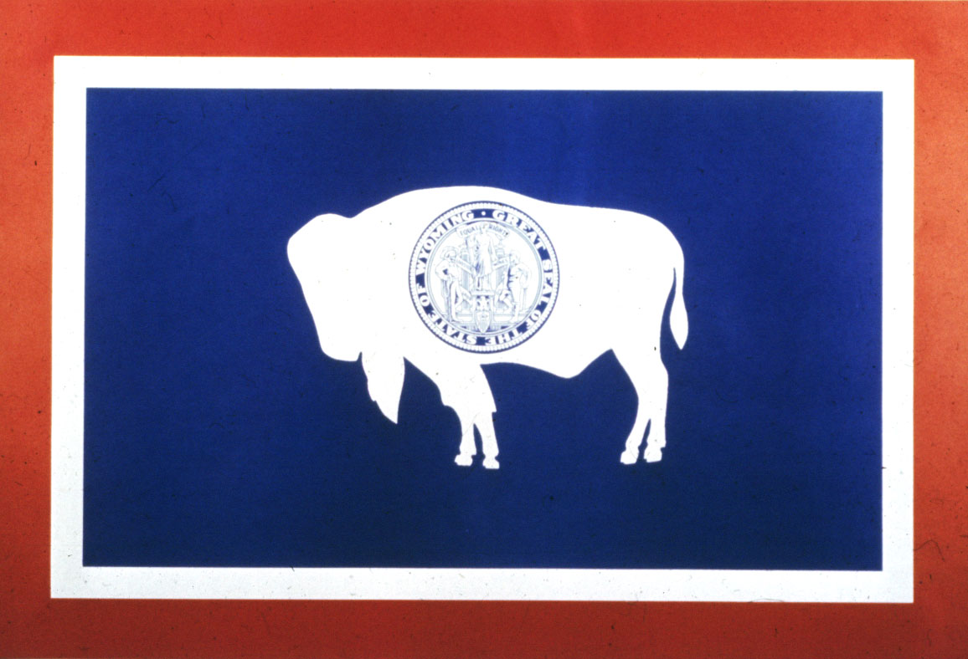
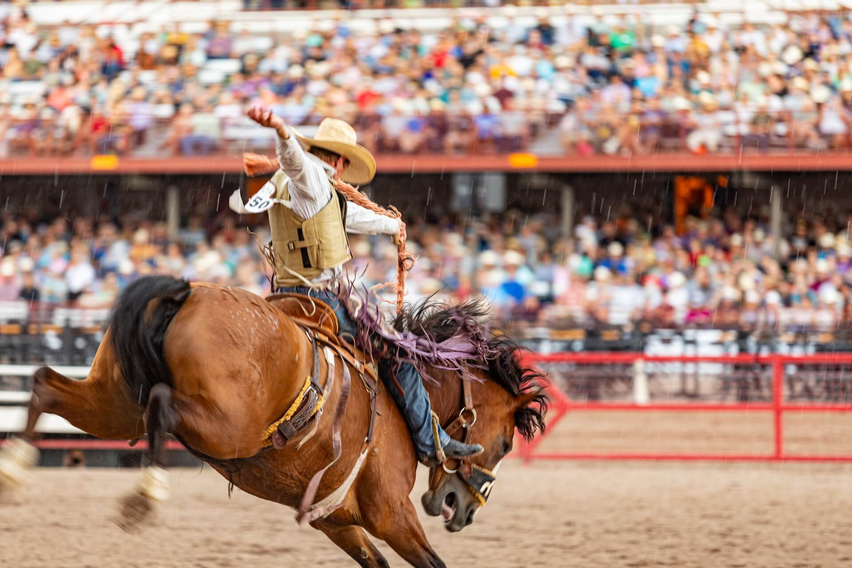
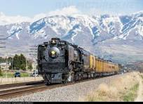
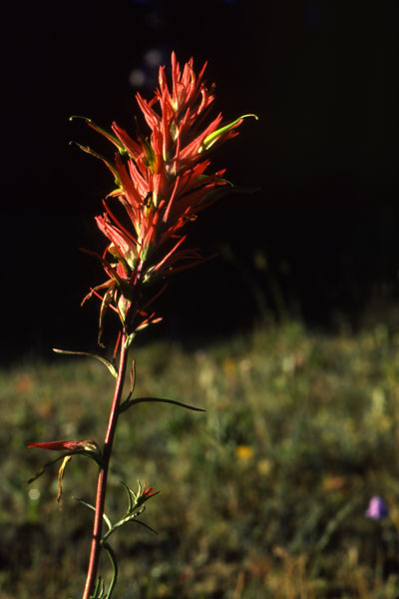
Information on Wyoming
State Nickname: Equality State, Cowboy State
Population: 493,782 (2000 Census)
Square Miles: 97,914
Highest Point: Gannet Peak at 13,804 feet
Lowest Point: Belle Fourche River at 3,100 feet
State Flower: Indian Paintbrush (Castilleja linariaefolia), 1917
State Bird: Western Meadowlark (Sturnella neglecta), 1927
State Tree: Cottonwood (Populus Sargentii), 1947
State Mammal: Bison, 1985
State Fish: Cutthroat trout (Salmo clarki), 1987
State Gemstone: Jade (Nephrite), 1967
State Fossil: Knightia, 1987
State Reptile: Horned Toad (Phrynosoma douglassi brevirostre (Girad)), 1993
State Dinosaur: Triceratops, 1994
State Sport: Rodeo, 2003
State Coin: Sacajawea Golden Dollar Coin, 2004
Industries: The leading industries in Wyoming are minerals, recreation, tourism and agriculture.

Slide 22
Wyoming’s Bucking Horse and Rider
The "Bucking Horse & Rider" is recognized worldwide as the insignia for Wyoming and is our federally registered trademark.
The State of Wyoming's first use of the BH&R mark dates back to 1918. BH&R is representative of a legendary rodeo horse named "Steamboat" dating back to the early 1900's. One of the best-known bucking horse of all time, Steamboat was known as "the horse that couldn't be ridden!"
The BH&R was used as an insignia worn by members of the Wyoming National Guard in France and Germany during World War I. In 1935, Secretary Hunt proposed the legislation which permitted the Secretary of State to make changes to the license plate design as was deemed necessary to combat the problem of wide-spread counterfeiting of Wyoming's license plate.
In 1936, Wyoming's unique license plates containing the BH&R made their debut. During that same year, the state obtained a copyright for the mark.
Between 1936 and 2024, the BH&R's use by Wyomingites and the State of Wyoming was continuous and extensive. A few years ago, the “307,” also became known as a Wyoming symbol. The State’s only area code to date!

Slide 23
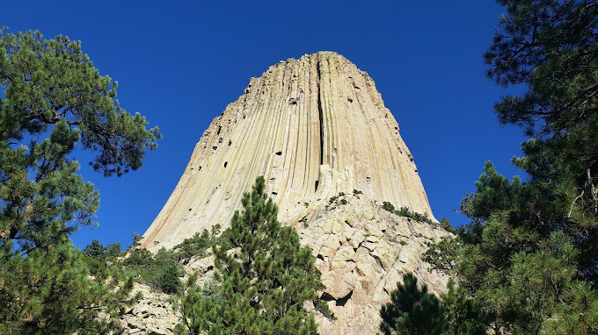
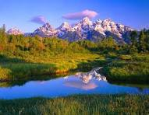
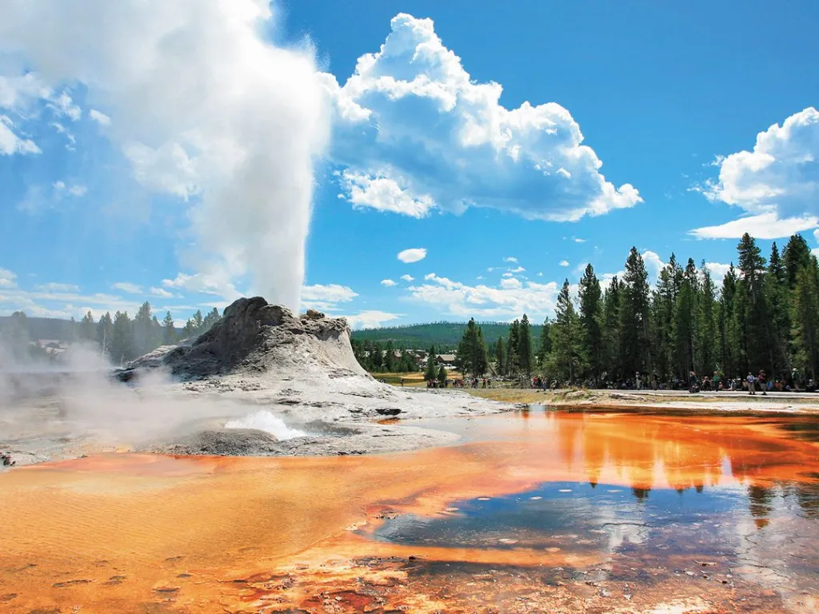
Wyoming National Parks & National Monuments:
Yellowstone National Park- 1st National Park in the U.S.
Grand Teton National Park
Ft. Laramie National Historic Site
Devils’ Tower National Monument – 1st Monument in the U.S.
Fossil Butte National Monument
Bighorn Canyon National Recreation Area
Flaming Gorge National Recreation Area
Continental Divide Trail

Slide 24
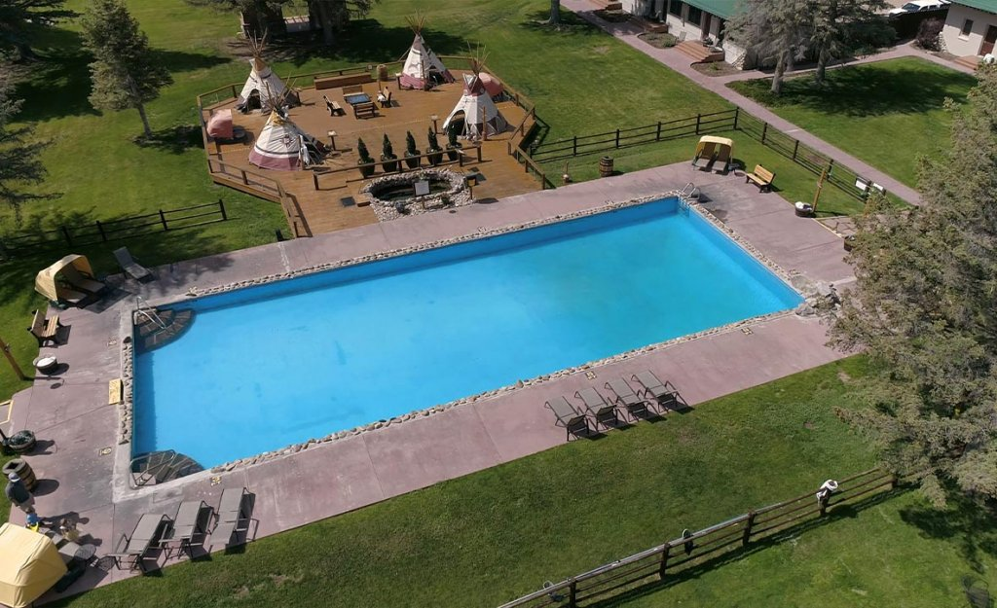
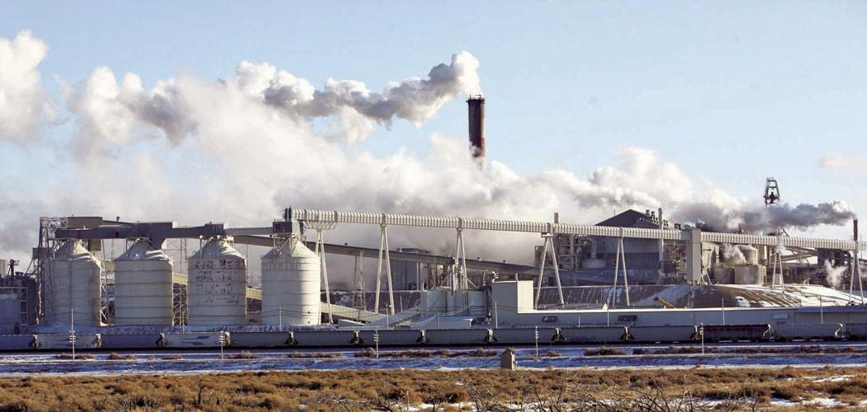
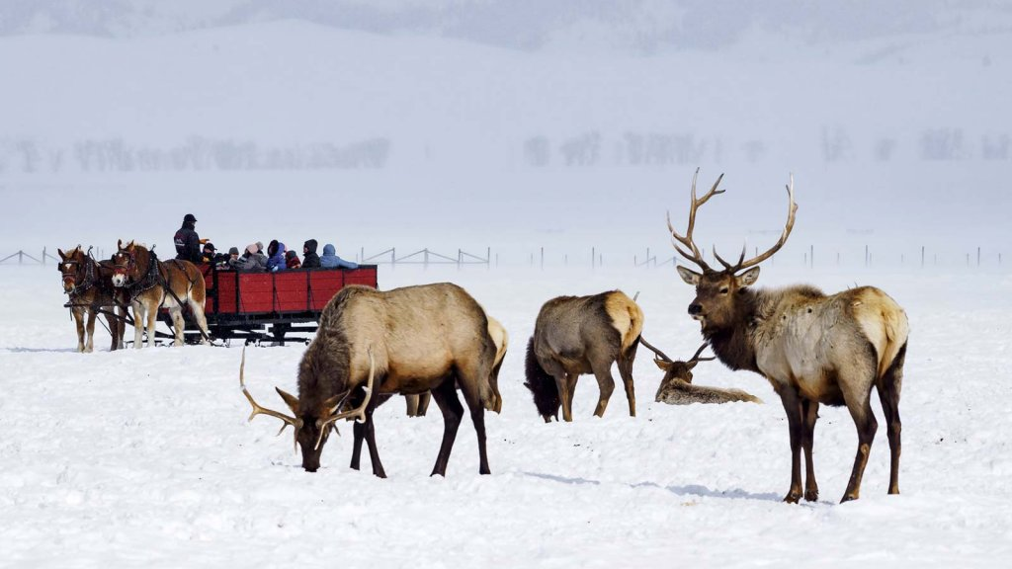
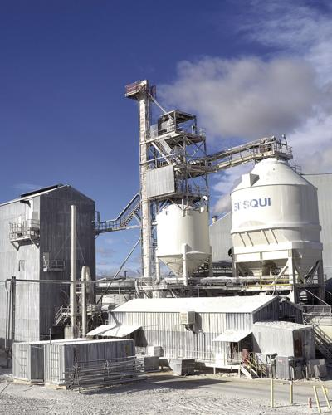
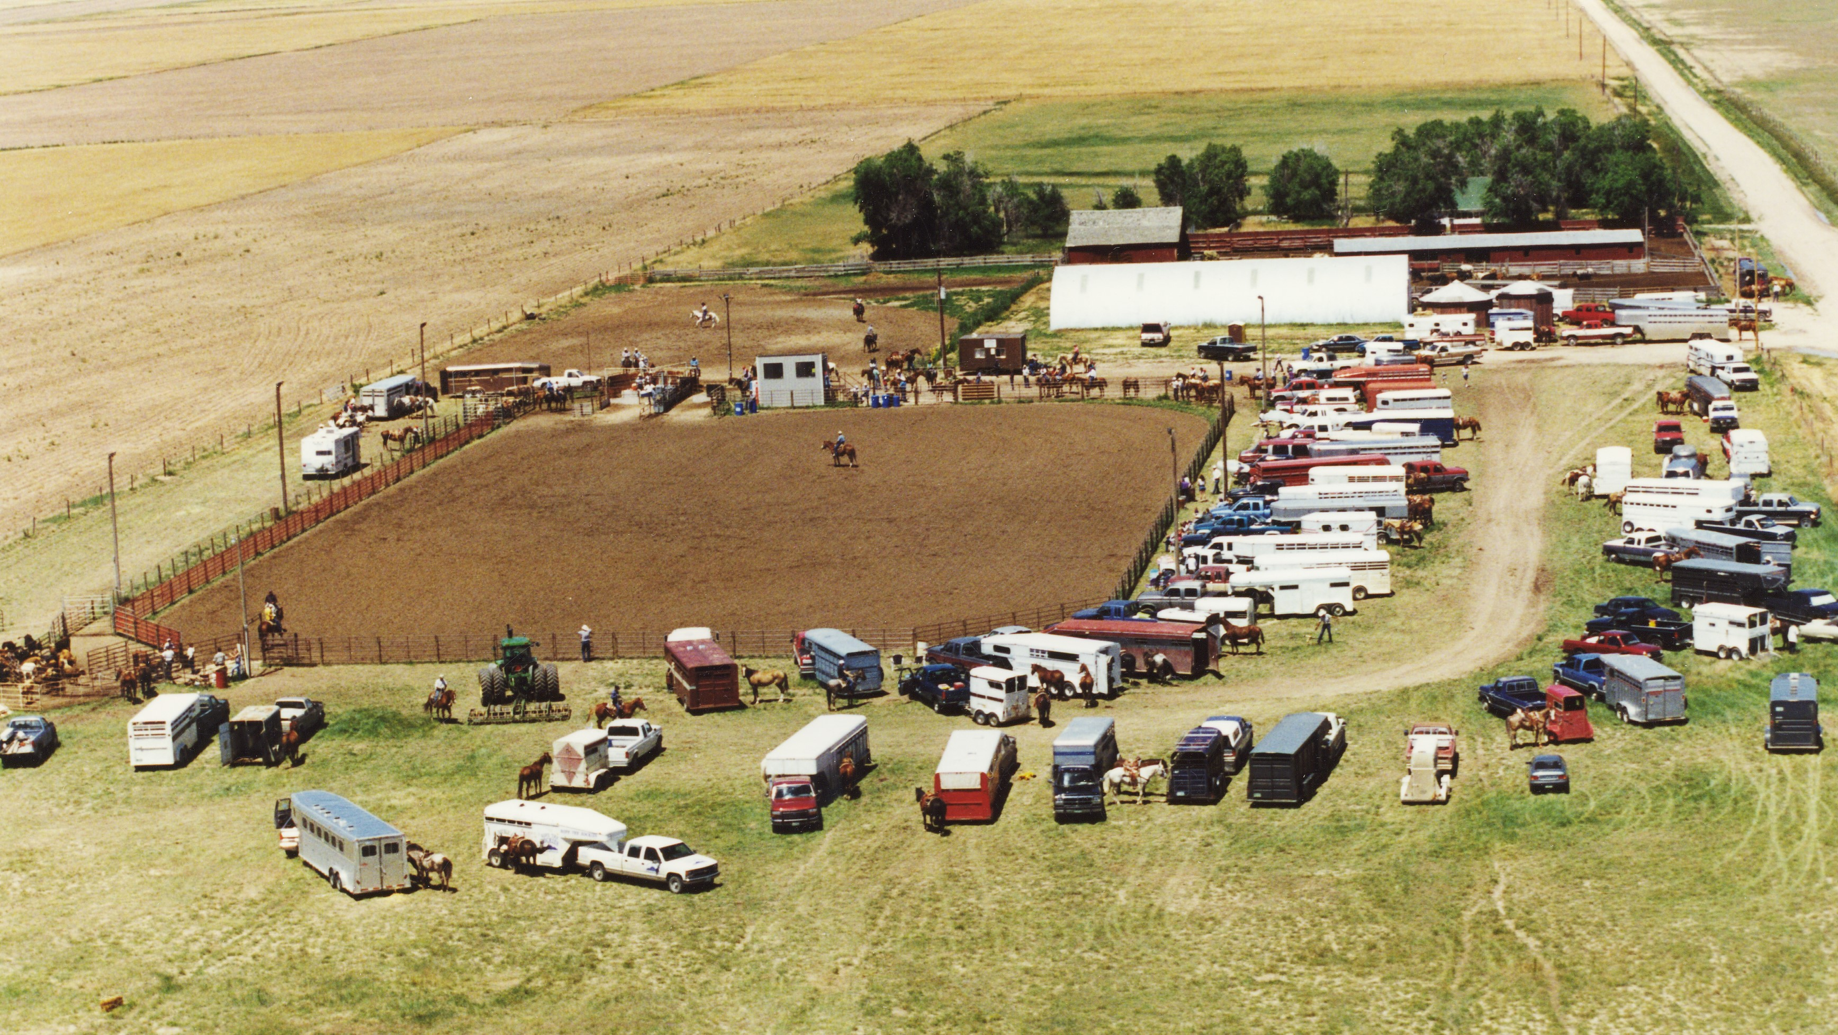
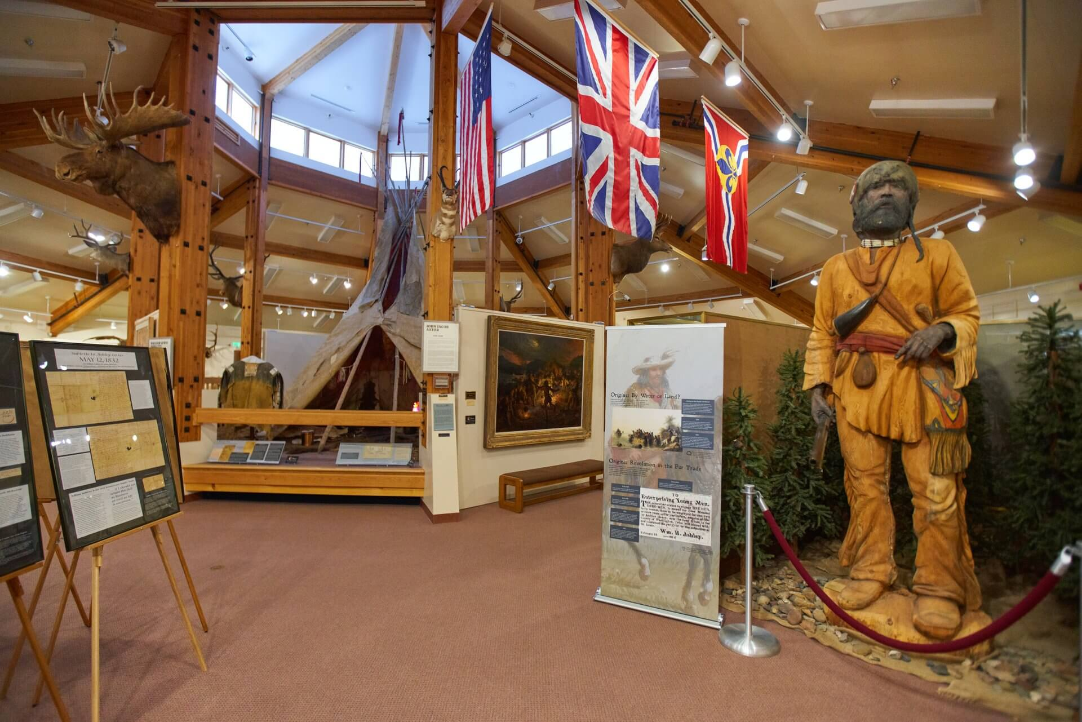
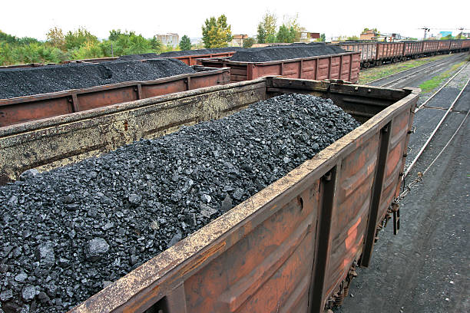
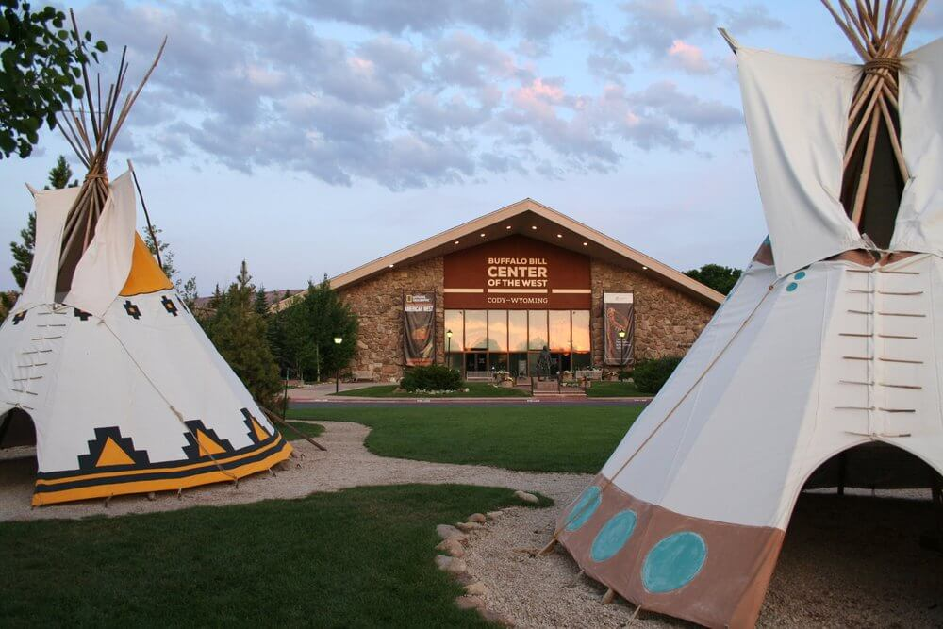
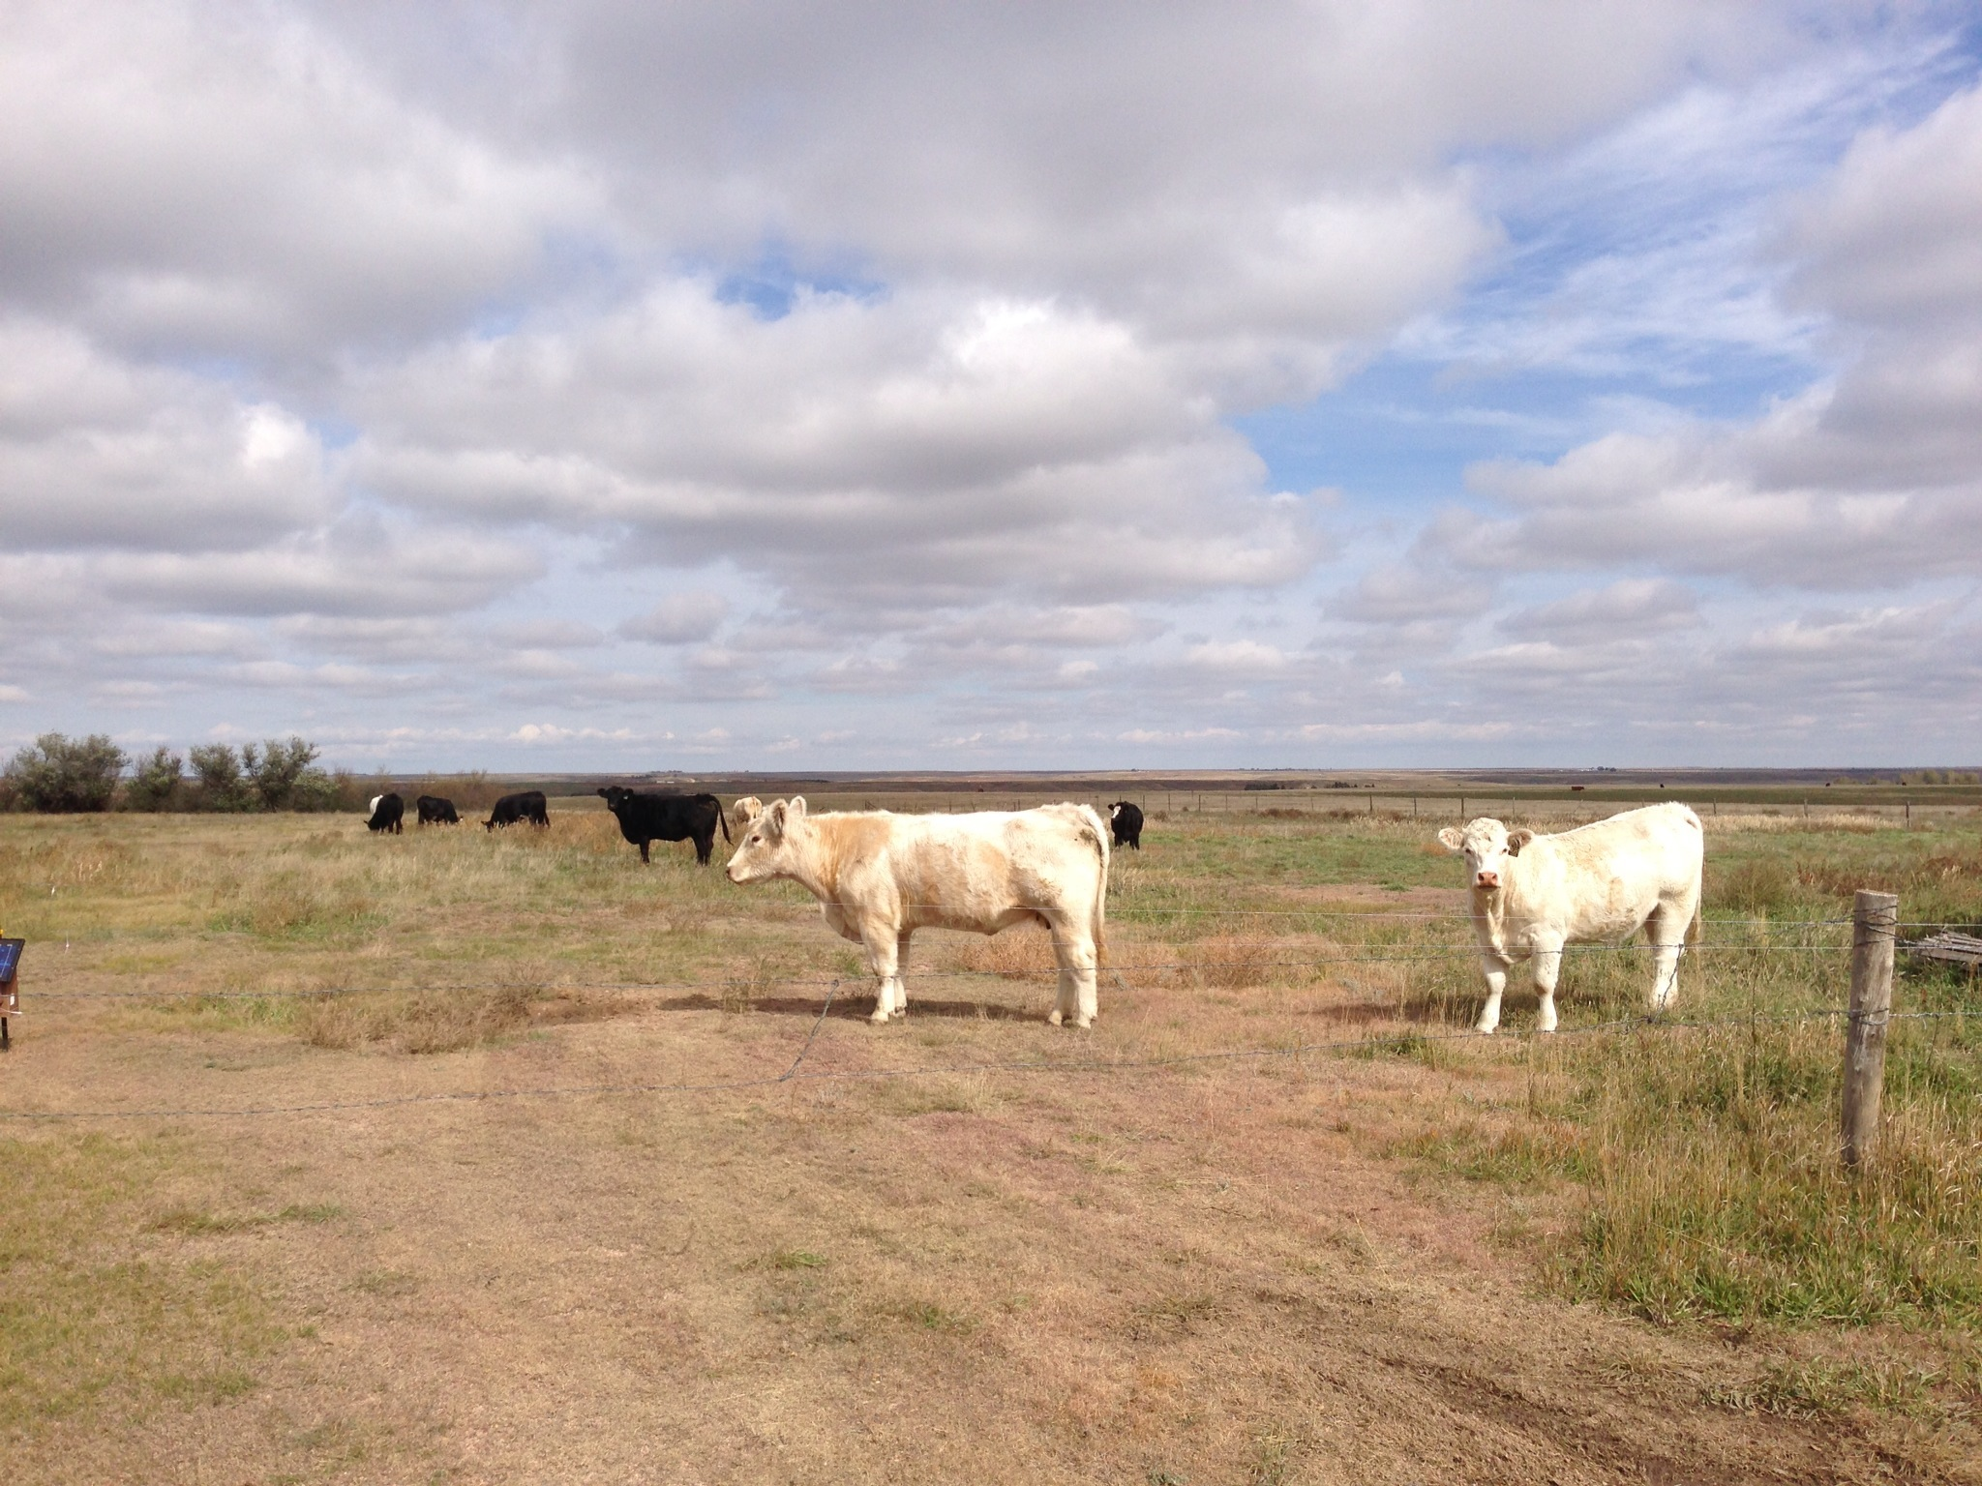
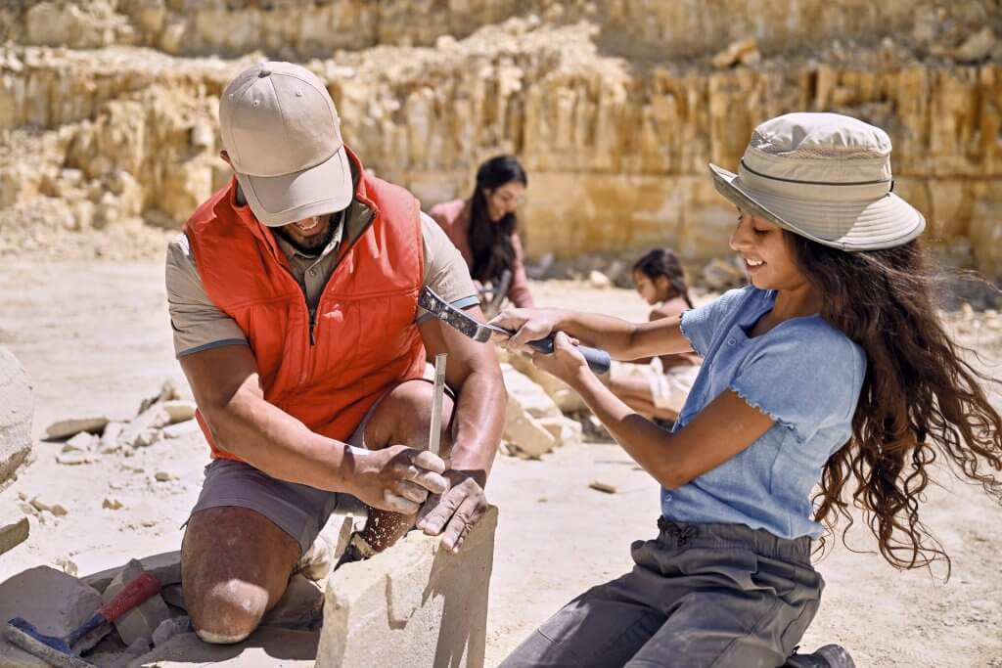
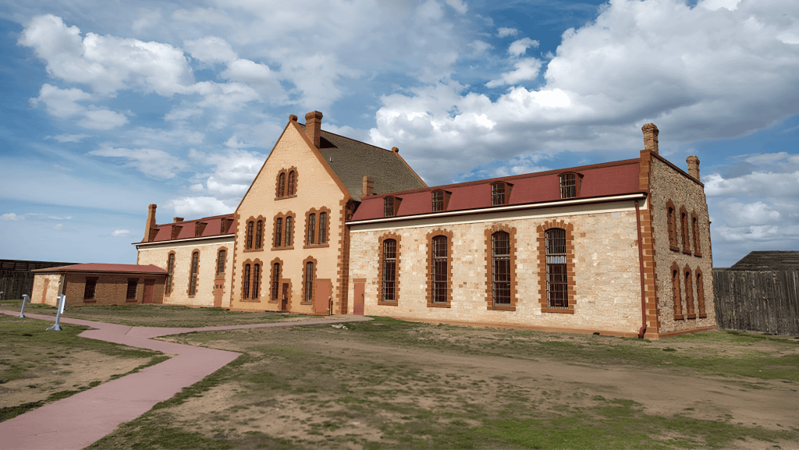
Wyoming Economy
Wyoming’s economy is heavily tied to
Agriculture (primarily the marketing of beef cattle and sheep).
Mining (Coal, Trona, Rare Earth Minerals)
The state also has an important and growing tourist industry, serving millions of visitors to the state’s Historic Sites, National and State Parks

Slide 25
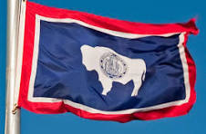
Firsts in Wyoming
First Business West of the Missouri River: In 1834, Fort William was erected at the confluence of the Laramie and North Platte Rivers by fur traders William Sublette and Robert Campbell. Thus, the first trading post west of the Missouri River was established.
First Women to Vote: John A. Campbell, Wyoming’s first Territorial Governor, signed a bill December 10, 1869 making Wyoming the first state to grant women the right to vote.
First Woman Justice of the Peace: Esther Hobart Morris was appointed February 17, 1870 in South Pass City.
First All Woman Jury: The first all woman jury was sworn in March 7, 1870 in Laramie.
First Woman Bailiff: In 1870, Mary Atkinson of Albany County was appointed the first woman bailiff in the world.
First National Park: In 1872, Congress named Yellowstone National Park in northwestern Wyoming as the first national park in the world.
First State to Have a County Public Library System: The Laramie County Public Library System was organized in August of 1886, and had a Carnegie Library building.
First National Forest: By an Act signed by President Benjamin Harrison in 1891, Shoshone National Forest became the first national forest. Wyoming now has nine national forests.
First Ranger Station: Wapiti Ranger Station was established in the Shoshone National Forest in 1891.
First Woman Statewide Elected Official: Estelle Reel Meyer was elected as Superintendent of Public Instruction in 1894.
First National Monument: Devils Tower in northeastern Wyoming was designated the first national monument by President Theodore Roosevelt in 1906.
First Town in America to be Governed Entirely by Women: The city of Jackson, from 1920 to 1921, had a woman mayor, town council and town marshall. One of the councilwomen defeated her husband for her council seat.
First Artificially Lit Evening Football Game: The first interscholastic football game to be played under artificial light took place in Midwest, Wyoming in 1925.
First Woman Governor in the U.S.: Nellie Tayloe Ross was elected to complete the term of her husband who died in office. She served from 1925 to 1927. In 1933, President Franklin D. Roosevelt appointed her the first woman to head the U.S. Mint, a position she held until 1953.

Slide 26
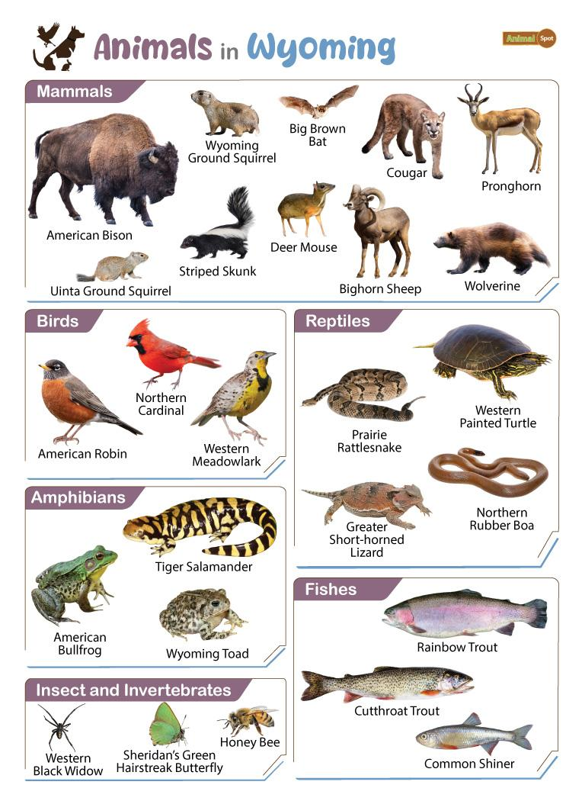

Slide 27
Questions????

